Slide 1
Lecture 12: Vulnerabilities, Risk, Patching, and Principles CS 07351: Cyber Security: Fundamentals, Principles and Applications Dr. Vahid Heydari

Slide 2
Copyright Note
All slides used in this class are provided by Old Dominion University and the University of Alabama in Huntsville
Note: The slides are modified by the instructor.

Slide 3
Agenda
Risk assessment
Patching
Fundamental Security Design Principles

Slide 4
Risk Definition
an event that, if it occurs, adversely affects the ability of an engineering system (including cyber) to achieve its outcome objectives (Garvey, 2008).
The possibility of loss or injury
The chance an unwanted event occurs
In economics, this question is answered in terms of a person’s monetary perspective or value structure
Requires human interpretation and value judgments specific to a situation

Slide 5
Measuring Risk
A general expression for measuring risk is given by (Garvey, 2008) as
Risk = f(Probability, Consequence)
Notes:
If our company has a webserver and there’s a DOS attack, the consequence is that the webpage isn’t available = lose money because we can’t sell anything on the website. Then, we need to calculate the probability of an attack happening?

Slide 6
Risk Management
Risk management is a formal process used to continuously identify, analyze, and adjudicate events that, if they occur, have unwanted impacts on a system’s ability to achieve its outcome objectives (Garvey, 2008).
Notes:
So what does it mean to manage and assess risk?
Right now this would suffice as our description of what risk management is. We just need a general description for now, and we will refine this as we go through time.
So we can describe right now risk management as a formal process used to continuously identify, analyze, and adjudicate events that, if they occur, have unwanted impacts on a system’s ability to achieve its outcome objectives.
We will try to split this description into several things.

Slide 7
Objectives of Risk Management
Early and continuous identification, management, and resolution of risks so that engineering a system (including cyber element) is accomplished within cost, delivered on time, and meets performance requirements.
Notes:
One of the objectives, when we're trying to manage risk is early and continuous identification, management and resolution of risks.
And what would be our constraints, such that engineering a system is accomplished within what we earlier said about the project: Within cost, within schedule, and within quality or performance requirements.

Slide 8
Why is Risk Management Important?
It fosters the early and continuous identification of risks
It enables risk-informed decision making and course-of-action planning
It enables identified risk events to be mapped to the various components of a system (including cyber components)
It helps identify where management should consider allocating limited (or competing) resources
It can be designed to provide management with situational awareness in terms of a system’s (including cyber components) risk status
Notes:
4. Where should we use the security tools? Where should we pay and how much?

Slide 9
Risk Assessment
A risk assessment is a process to identify potential hazards and analyze what could happen if a hazard occurs.

Slide 10
Risk Assessment
Many tools, processes, and consultants are available to paid perform risk assessment process.
Microsoft Security Assessment Tool (MSAT) “is a risk-assessment application designed to provide information and recommendations about best practices for security within an information technology (IT) infrastructure.”
Cybersecurity Evaluation Tool (CSET) – “provides users with a systematic and repeatable approach to assessing the security posture of their cyber systems and networks”

Slide 11
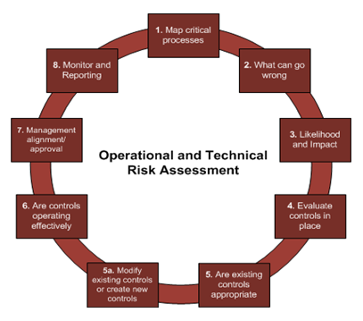
Risk Assessment, cont’d
Risk assessment is a team based activity.
Management
IT
Users
Risk assessment expert
Notes:
Where are critical processes [that we need to protect]
For ex. Attackers may be able to penetrate customer database
How likely is it for attackers to have access to customer data based on security solutions + how it can affect us, like cost and all
Do we have authentication set up? Do we have certain security measures? Etc.
Is the security we have enough? Do we need something more secure?
If we install it on a high-speed device, do we need to add more? Is the device enough?
Talk to the decision makers of the company and explain findings, this is the cost and they need to decide
Continue this process (cannot just do something and then it’s done), continuously monitor and create reports on what’s happening on the systems (not one time), need a group in the company dedicated to this because new threats come up daily

Slide 12
Patching
Software is generally supported after the sale/delivery via patching.
Patching is releasing a software update to fix bugs, close security holes, upgrade, etc.
Patching is a common method to close security holes.

Slide 13
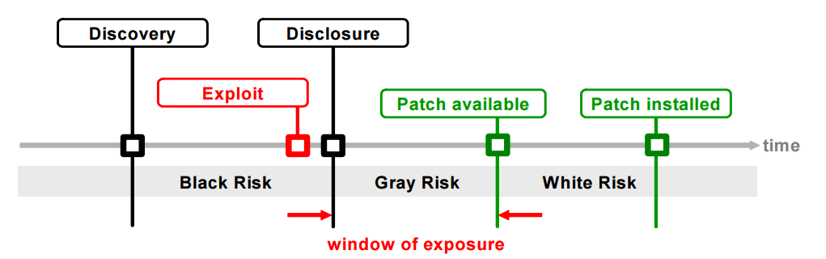
Vulnerability Window
Vulnerability window starts at when the first exploit is created and ends at patch deployment (patch installed).
Generally exploit date is unknown. Discovery also unknown is discovered by attackers.
Figure credit: http://www.techzoom.net/Papers/0-Day_Patch_Exposing_Vendors_Patch_Performance_(2008).pdf
Notes:
0-day vulnerability (discovery)
Exploit for that (someone created it and now It can be used to infiltrate system due to vulnerability)
Time between exploit and disclosure (company finds out about vulnerability due to a good guy or someone found it and reported it)
It takes time for the company to create the patch
Then for users to install the patch
The greatest vulnerability is the window of exposure (nothing to prevent infiltration until patch) from the time when the first exploit is created to the time the patch is installed (the picture is misleading)
Takes 3-5 years from discovery that we could have a patch for it (attackers won’t disclose them to the company)
No exposure at discovery b/c the exploit hasn’t been made yet

Slide 14
Patch Tuesday
Microsoft releases OS patches 1 time per month on a Tuesday.
Second Tuesday of each month.
Tuesday is purposeful. Gives time to deploy before the weekend. Assumes Mondays are busy dealing with issues from the weekend.
What is “Exploit Wednesday”?
Hackers analyze patch and deliver exploit before patch can be completely deployed.
Notes:
When company publish a patch, they’ll say what was wrong that warrants the patch
Installing patches on users take time (many won’t be aware) and use the well-known vulnerabilities told through those patch descriptions

Slide 15
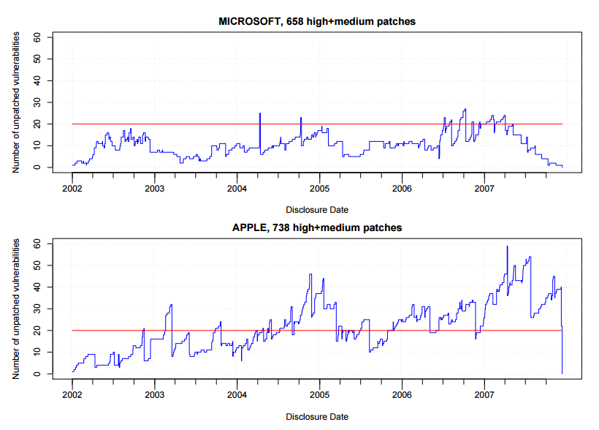
Not all vulnerabilities patched immediately
Figure credit: http://www.techzoom.net/Papers/0-Day_Patch_Exposing_Vendors_Patch_Performance_(2008).pdf
Notes:
Should they stop making another version or release a patch for the previous version?
Many companies don’t have a patch (don’t have capabilities)
Should they ignore older operating systems (but they’re in use in several important places)?

Slide 16
Patching critical systems
Critical systems must be tested before deploying a patch.
Interoperability testing - before releasing the patch
confirm critical functionality
Re-validate security conformance

Slide 17
Patch Management
Patch management should be a formal process. Not ad-hoc.
There are software tools to manage the patch management process
Monitor vulnerability releases
Deploy patches
Monitor uptake
Notes:
You should have a plan to monitor vulnerabilities and installing new patches.
Figure out when there’s going to be a patch and monitor releases, install them all and monitor systems to make sure that it works.

Slide 18
Fundamental Security Design Principles

Slide 19
Fail Safe/Fail Secure
Fail safe - in the event of a failure, system responds in a way that will cause no harm
Different systems have different requirements
Industrial – safety first, minimize harm (financial, customer interruption)
Fail secure - access or data will not be compromised due to failure
Notes:
Is it possible to have both happen at the same time?

Slide 20
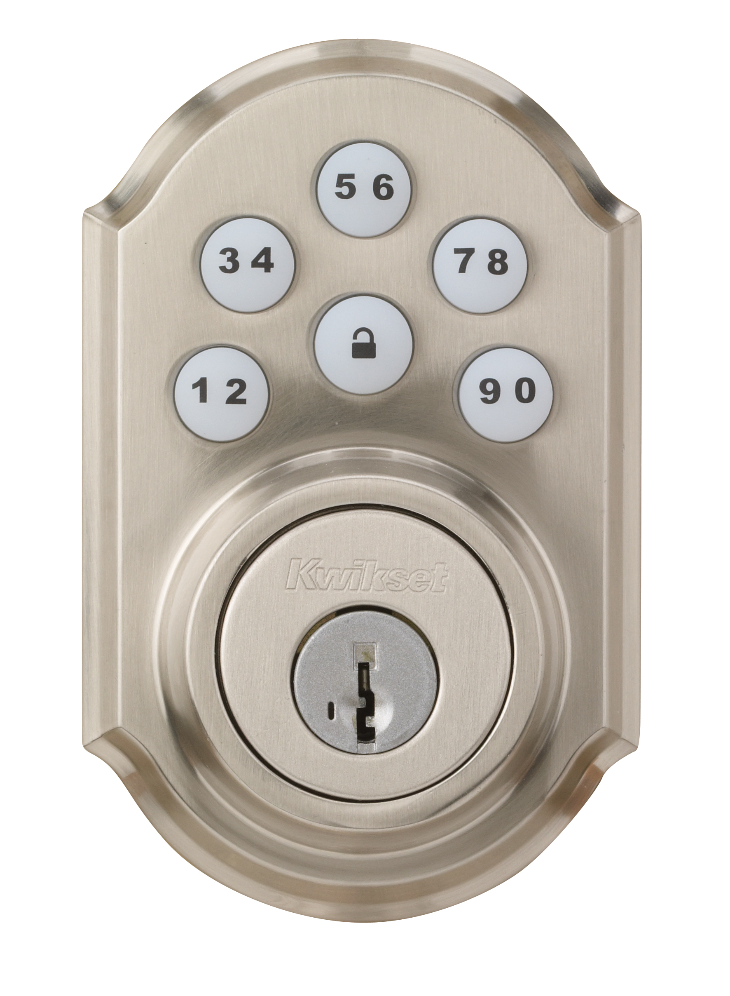
Fail Safe/Fail Secure
Fail safe and fail secure can conflict.
Push design in different directions?
Which wins?
Likely failsafe.
Lock example
Fail safe: fail unlocked – power to lock
Fail secure: fail locked – power to unlock
Notes:
Lock should be designed so that power is needed to lock it (power outage = unlock)
If there is a power outage, it gets to be locked
You need to find a way to have both of them (people who are inside can get out, but people outside can’t get in, which is both fail safe and fail secure)

Slide 21
Layering
Definition – using overlapping security defenses to attempt to overcome failure at one layer with another
Example
Firewall
Spam detection
Virus/malware detection
User account controls (UAC)
Notes:
Multiple layers of security instead of just one

Slide 22
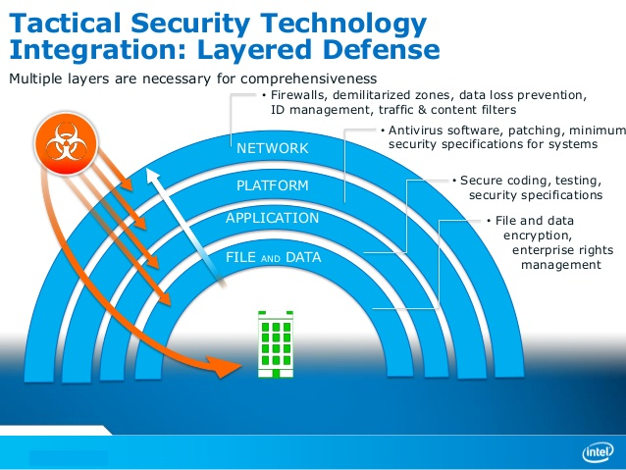
Notes:
File and data – encryption
Application – secure programing/applications
Platform – operating system (antiviruses, patches, automatic updates)
Network – firewalls, intrusion detection

Slide 23
Defense in Depth
Defense in Depth (also known as Castle Approach) is an information assurance (IA) concept in which multiple layers of security controls (defense) are placed throughout an information technology (IT) system.
A countermeasure can, and will be defeated. Defense in depth provides layers of protection.
Notes:
Never consider any security tool as 100% secure

Slide 24
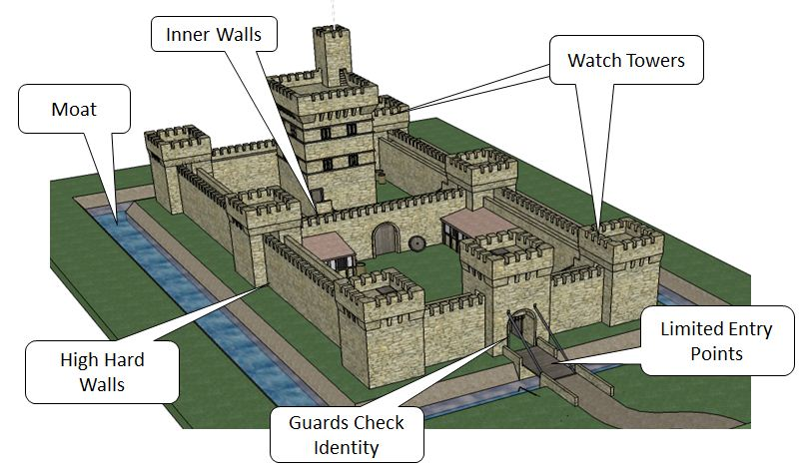
Defense in depth
Troops on walls
Draw bridge
Compartmentalized interior (inner area with keep)

Slide 25
Defense in depth
Castle | Stored Secret
Moat | Computational infeasible barrier (encryption)
Outer Walls | Firewall, access control, access control list
Watch tower | Monitoring, intrusion detection systems
Limited entry | Same. This follows the cybersecurity principle of minimization. In this case, limit the threat by limiting the entry points.
Guard check | Access control (passwords, Radius, Kerberos)
Troops on wall | Intrusion Prevention System
Draw bridge | Close unused ports
Compartmentalized interior (inner wall) | Using Virtual Machines
Notes:
Moat – prevents others from coming close to the building (data)
Limited entry points – closing unnecessary ports/minimum ports
Multiple parts – virtual machines is good, you can easily recover snapshot (better than current operating systems), you can open it inside a virtual machine and recover things

Slide 26
Minimization
Minimize secrets
Hard to keep secrets, so keep them to a minimum
Minimize common mechanisms
Use Principle of Least Common Mechanism
Minimize shared communication paths
Turn off unneeded features ( Does Bluetooth need to be on?)
Turn off ports that are not needed (will you need ftp on this machine?)
Domain separation
Process isolation
Resource encapsulation
Minimize access
Principle of least privilege
Notes:
Ex. Do you really need Bluetooth on your OS?

Slide 27
Modularity
Write code in small self-contained units.
Easier maintenance
Easier testing
The goals for each module
Single purpose
Small: easily read and grasped by a human
Simple: promotes human understanding
Easier to assess via code review
Notes:
Don’t put all of your code in one function, use multiple function – easier to test, can help divide the problem and work on certain parts

Slide 28
Open Design
Claude Shannon’s 1948 maxim: “The enemy knows the system.”
When we hide the design we are only hiding from those that can help improve it.
Review code/protocols openly to maximize feedback.
Example: AES encryption was developed and refined using an open process.
Notes:
Use open source (everyone can review code and give feedback), which is why Linux better than Microsoft operating systems, which is why it’s secure (everyone can participate to help improve it)

Slide 29
Simplicity & Usability
Maximize ease of use.
Easy to use promotes use.
Hard to use promotes user avoidance.
Notes:
Make it as simple as possible, great in improving security
Increasing complexity -> decreases security

Slide 30
Least Astonishment
A component of a system or an artifact should behave in a manner consistent with how users of that component are likely to expect it to behave; that is, users should not be astonished at the way it behaves.
Example: The buttons to minimize/close/maximize an application window are on the left in Macs but it is right on Windows machines.
If this setting was changed in your Windows machine, how would it affect you?
Notes:
Go through the standards (how users want that to behave) and use it the same way
Make it very similar to other login pages so users can work with it easily

Slide 31
Domain Separation
A 17th century proverb says
“Good fences make good neighbors.”
Domain separation is a way to separate data and/or systems into logically-defined domains.
Allows access to be more tightly controlled.
Ensures that communications between domains are allowed only as authorized.
If one domain is compromised, domain separation protects the other domains from compromise and contains the incident, limiting the damage.
Notes:
Multiple domains – if one is compromised, protects others

Slide 32
Domain Separation in a Hospital
One can define various domains in hospital
For example, each department operates in its own domain.
Management Domain – Patient Domain- Doctor Domain-Nurse Domain
Certain resources are shared between domains
Same building
Registration system
Other resources are not

Slide 33
Process Isolation
Process isolation is segregating a process so that it can only access the resources allocated for it.
It protects the system by limiting the effects that one process can have upon other processes.
For example a software process on the computer is allocated a part of memory and is not allowed to access other memory in the system except for shared resources.
With process isolation
A resource can be made available for exclusive access by one process.
When processes end, the resources they held are reclaimed by the system.
Operating systems use various hardware and software technologies to enforce process isolation.
Notes:
Why we use multiple processes on operating systems

Slide 34
Process Isolation in the Hospital Scenario
Consider a process to be the process that a patient goes through starting with entering the hospital to leaving the hospital.
Two patients (processes) will share some resources (e.g. wait in the same waiting room); if they are both patients of the same domain say, ENT, they may share more resources (e.g. the same nurse takes their pulse). Once they go into the doctor’s room they are isolated. Each will see a doctor in a different room. The doctor will not be checking the two patients at the same time.
What could be drawbacks of the two patients being seen by the doctor at the same time?
Notes:
Tradeoff: If a doctor could see two patients at the same time, more patients could be taken care of. The financial gains for the doctors and the hospital could be larger. However, a mistake when the doctor is dealing with two patients (mixing of reports or medication) could have serious if not lethal consequences.

Slide 35
Resource Encapsulation
Resource encapsulation is the inclusion of all resources (data/methods) needed for an object to function within the object itself.
The resources are protected and not directly accessible by a subject.
Helps with information hiding
The object publishes its interfaces. Other objects adhere to these interfaces to use the object without having to be concerned with how the object accomplishes it. The idea is "don't tell me how you do it; just do it."
In programming, resource encapsulation is one of the main principles of object oriented design.
Notes:
Very popular in object oriented design programming

Slide 36
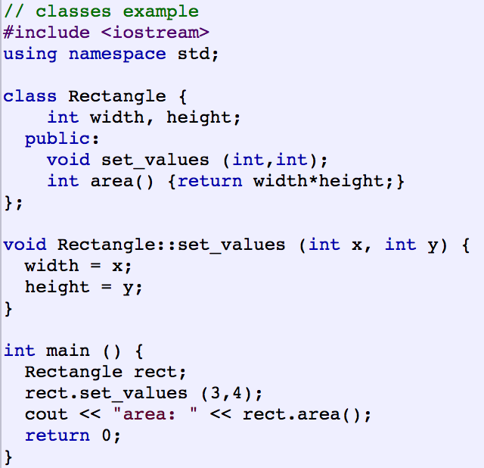
C++ Class
Notes:
We cannot directly change the value of height, we have to use the function to do so

Slide 37
Resource Encapsulation in the Hospital Scenario
Think of the medication for a patient as a resource .
Suppose the medication is encapsulated in a dispenser.
There is a code to dispense the medicine for the patient in the right dose and this is the only way to access this medicine.
The nurse who needs to administer the medicine will have the code; will be able to dispense but not modify it.
What are the security implications of resource encapsulation in this scenario?
Notes:
What could happen if the medications were not encapsulated?
A nurse could pick the wrong medication for a patient
A malicious person could swap medications, change doses, etc.
Note that there is still the “insider” risk; that is, there may be malicious intentions with authorized people.

Slide 38
Complete Mediation
Mediation in most general terms is to bring about an agreement. In computer science mediation becomes making sure that the access to a file by a user is authorized
Complete mediation is making sure that every access is mediated.
In computing, a cache is a hardware or software component that stores data so future requests for that data can be served faster.
Principle of Complete Mediation restricts the caching of information.
This often leads to simpler implementations of mechanisms and better security.
But in practice complete mediation is costly in terms of time and resources and caching is used
Notes:
Consider having all security principles, all costly, why we have risk management and assessment (consider consequence and probability, what kind of mediation do we need to have? What cost?)

Slide 39
Principle of Separation of Privilege
Ideally every access should be based on more than one condition so that defeating one protection system won't enable complete access.
Also called “Separation of Duty”
Well implemented in financial organizations:
Two keys required to open a safe-deposit box
Two signatures required on a check
Two-factor authentication:
Two different authentication mechanisms are needed

